Slide 1



Predicting whether Visitors Purchase after only one Click
Ayaan Gopalan ᐧ Tori Wang ᐧ Xi Wu ᐧ Ethan Young
Team Overfitters
Notes:
In general, slides should be more on the business side than technical. Focus on implications of findings on business
13 seconds
Notes:
Insert team name

Slide 2
Project Objective
Goal
Predict if a visitor to the Fingerhut site will make a purchase using only the data from their first server call
Challenge
Over 95% of visits do not result in a purchase, which presents difficulties in creating an accurate model
Application
Immediately generate predictions about every visitor to the Fingerhut site and tailor different marketing strategies for each one
Notes:
60 seconds
Ayaan
33 seconds
Add a graph at bottom demonstrating data imbalance
Notes
Like bolding
can bold challenging task for easier flow of eyesight

Slide 3





Project Roadmap
Objective
Neural Network
Future Work
Identify likely purchasers using only their first server call
Train a neural network and compare results to baseline
Optimize model and improve feature selection to increase accuracy
Feature Selection
Results
3-step procedure to select important features and narrow down large dataset
Different marketing strategies depending on the prediction
Notes:
60 seconds
Tori
32 seconds
Feature Selection: Employed 4 feature selection techniques to extract predictive variables from the initial 283 variable data set
Model Building: Using the selected feature set, trained a neural network to predict the probability of purchase after the first server call
Notes
darker lines in between
don’t call it a roadmap
focus on ben as an audience
less jargon (e.g. hyperparameters)
larger font

Slide 4
Feature Selection (1/2)
Extracted the first server calls from all visits in the original dataset, then employed a 3-step feature selection process to narrow down the variables:
1
2
3
Variables with missing values
Variance Threshold
Random Forest Feature Importance
Variables with at least 95% missing values were removed
Variables where at least 99% of the values were similar were removed
Trained a random forest classifier and extracted the top 20 variables in terms of feature importance
* More details about feature selection process are in the Technical Details slides
Notes:
60 seconds
Ayaan
1:03 min/seconds
Notes
need to clarify the dataset we end up with (e.g., top 50 features of the dataset, subsetted by the first clicks of users)
users are labeled non-purchasers if their visit that day did not end with a purchase and users are labeled purchasers if their visit that day did
change wording to make it clearer (e.g., at least as)

Slide 5
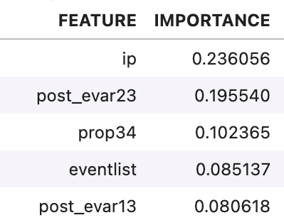
Feature Selection (2/2)
Final Data Set
The final subsetted data set consisted of 20 variables from all of the first server calls, and a binary variable denoting if a visit resulted in a purchase
Random Forest Feature Importance: Top 5 Variables
IP address
Last Member ID value
Pipeline Session ID
List of events triggered
Last platform value
Notes:
60 seconds
Ayaan
1:03 min/seconds
Notes
need to clarify the dataset we end up with (e.g., top 50 features of the dataset, subsetted by the first clicks of users)
users are labeled non-purchasers if their visit that day did not end with a purchase and users are labeled purchasers if their visit that day did
change wording to make it clearer (e.g., at least as)

Slide 6
Models
2 Hidden Layers
We implemented 2 models using the dataset with the 20 most important variables:
Input
(Training Data w/ 50 Features)
Output
(Purchase or
No Purchase)
Logistic Regression (Baseline)
Trained with class weight balances
Fast computation, but struggles with imbalanced data
Shallow Neural Network
Trained using undersampled data
More flexible model that performs comparatively better
Diagram of the neural network
(A detailed version is in the Technical Details slides)
Notes:
60 seconds
Tori (LR) and Ethan (NN)
57 seconds
Tori: Include output of both models are values between 0 and 1 that can be interpreted as the probability a user will make a purchase
Notes
mention data that we’re working with and how we are training the model
backup slide to include information about a neural network and basics
can include some references for help
limit for technical info
can include word shallow
impression that input and hidden layers have the same number of nodes (increase number of circles in hidden layer)
Include definition of hyperparameters (intuitively can be thought of as settings of the network that are chosen before it predicts any kind of data (e.g., number of layers))

Slide 7
Applications of Results
Plug in data collected in real time to pre-trained model to make predictions
Possible strategy based on if a user will:
Purchase: optimize search results and offer promotional codes based on subsequent page visits
Not purchase: show personalized homepage with targeted item recommendations
Retrain neural network seasonally using data from the previous year
Opportunity to understand how customer behavior can vary throughout the year
Using a larger dataset helps train a more robust model that predicts more consistently and with more confidence
* Details of model performance are in the Technical Details slides
Notes:
75 seconds
Ethan
1:14 min/seconds
Notes
Clarify motivation for each recommendation
justify intuition (or state explicitly that it’s our intuition)
add sentence for putting results in technical backup slides
exploring the robustness of our model can be interesting as we can see if different seasons builds a model that predicts user behavior differently

Slide 8
Limitations & Future Work
Data
Only 1 week of data limits applicability of results
Features selected are predictive, but may not always be of practical interest
Incorporate 2nd, 3rd, etc server calls to utilize more data as visitors spend more time on the site
Models
Methods addressing class (purchase / no purchase) imbalance introduce bias
Neural networks are flexible, but lack interpretability
Optimize neural network to improve model accuracy and confidence of predictions
Notes:
90 seconds
Xi
1:53 min/seconds
Notes
Practicality vs predictability tradeoff
Clarify motivation for each recommendation
justify intuition (or state explicitly that it’s our intuition)
add sentence for putting results in technical backup slides
Here, the squares indicate limitations of each area, the diamonds indicate work to be done in each area

Slide 9

Summary
Project Objective Revisited
Feature Selection
and Models
Sales and Advertising Strategy
~70% Accuracy
Can we predict which users will make a purchase using only their first server call?
Key challenge of most users not making a purchase
3-step feature selection and addressed the data imbalance
Results suggest variables in the first server call contains strong insights about the likelihood of purchase
Real time prediction to more accurately target different types of visitors with different strategies
Opportunity to retrain model with seasonal data
Notes:
75 seconds
Tori
52 seconds
Notes
clarify first server call variables (remind audience of what we’re working with)
Say the accuracy is not actually that low considering we are only looking at the first server call; however, a majority of the mistakes comes from the non-purchasers we plug into the model
Variables:
geocity
post_evar23: customer number
addonsymal=Evar30: Updated 2/6/20 - This now captures month's recency attribute from AudienceStream for order recency
emailsubscriptionremove: Captures the pageurl of every utag.view and utag.link call.
cdeincreasepayment = evar 44 :Tagged via tealium. Captures the credit_product from the utag on page load. If a user signs out this data is no longer captured.
prop44: Customer Attribute Tagging (Utag) (prop 44)
evar56

Slide 10
Thank you!

Slide 11
Technical Details

Slide 12
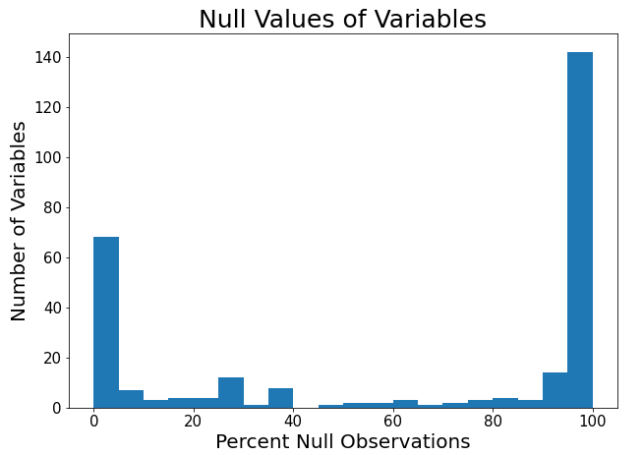
Feature Selection (1/4)
Variables with Missing Values
Because very few visits result in a purchase, we wanted to select variables that returned non-null values in the purchase visit first server calls
Step 1: Calculated the proportion of null values in the first server calls of purchase visits
Step 2: Graphed the distribution of null values in all the variables in a histogram
Step 3: Examining the histogram, we selected 95% or greater null values as the cutoff for values to remove
95%

Slide 13
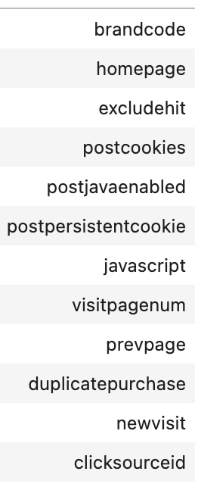
Feature Selection (2/4)
Variance Threshold
We wanted to remove variables that return the same value almost every time, as they are likely not as predictive of visit outcomes
Step 1: After removing variables from last step, converted null values in the remaining variables into their own category
Fixes any missing values issues, and could unlock useful information in variables
Step 2: Calculated the variance of these variables
Step 3: Removed all variables with a variance of 0.01 or lower (99% or more of the values are similar)
Removed Variables

Slide 14
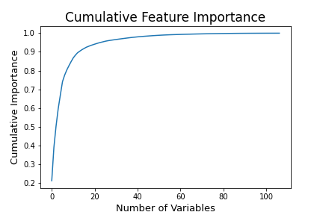
Feature Selection (3/4)
Random Forest Classifier
After subsetting based on missing values and variance, we wanted to further subset variables based on their predictivity of visit outcomes
Step 1: Trained a Random Forest Classifier on a undersampled data set of remaining variables
Scaled the numerical variables between 0 and 1
Encoded the categorical variables with target encoding
Step 2: Graphed the cumulative feature importance of the variables
Step 3: Examining the graph, selected the top 20 variables which captured about 94% of the feature importance

Slide 15
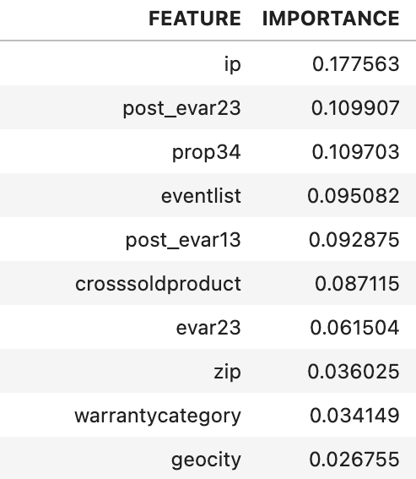
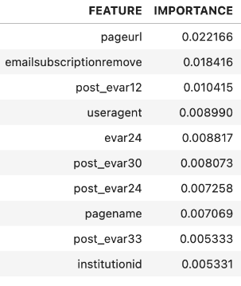
Feature Selection (4/4)
Final Data Set

Slide 16
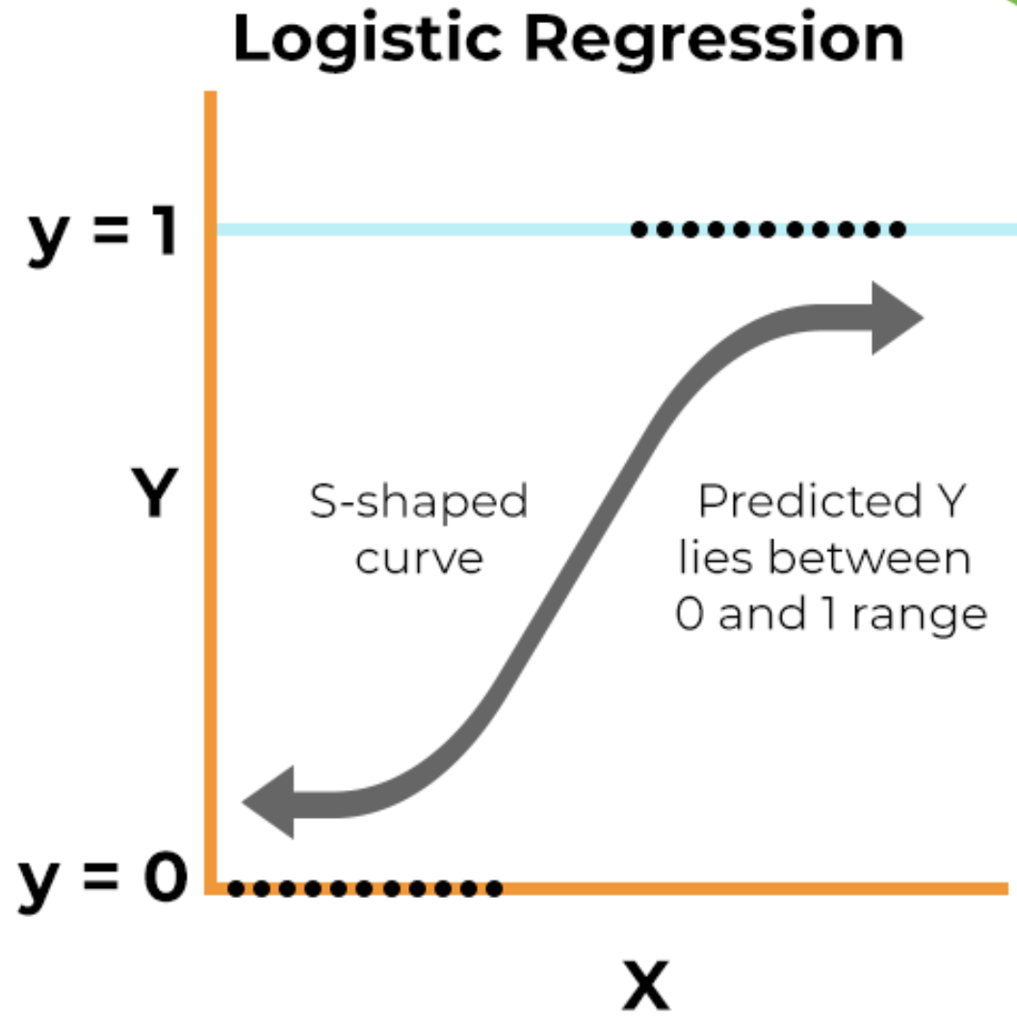
Logistic Regression (1/3)
Basics
Mathematically, logistic regression is the logarithm of the odds of an event:
log = β₀ + β₁𝑥₁ + β₂𝑥₂ + … + β_{𝑚}𝑥_{𝑚}
3 key assumptions:
Independent observations
No multicollinearity
No outliers
In (binary) classification, logistic regression is a regression technique that outputs a value between 0 and 1 (the input is labeled 0 if the output < 0.5 and 1 if > 0.5)
𝑝 ( 𝑦 =1)
( )
1 – 𝑝 ( 𝑦 =1)
Figure from this site

Slide 17
Logistic Regression (2/3)
Training and Testing Sets
Variables used in this model were the 20 most important features extracted during feature selection
Variables were then converted to numeric variables using ordinal encoding and then scaled, with outliers removed from the scaled dataset
Note: Our training and testing datasets were limited by issues working on computing clusters and the difficulty handling the large dataset on our personal computers
Size of training set (sampled from day 1): 46657
# users that purchase: 2439
# users that do not purchase: 44218
Size of testing set (sampled from day 6): 20000
# users that purchase: 1051
# users that do not purchase: 18949
Our model was trained using a dataset that had size: 4878. This is due to the fact that we used class weight balances in order to prevent our model from only predicting 0 or “no purchase’. This does result in some bias in our model.

Slide 18
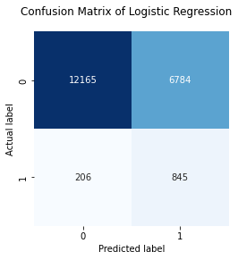
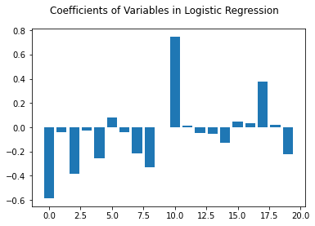
Logistic Regression (3/3)
Results
Test set accuracy rate: 0.6505
Variable Coefficients: (20 variables coded)
Notes:
Important variables include:
Feature: 0, Score: -0.58502, post_evar23: customer number
Feature: 20, Score: 0.34920, addonsymal=Evar30: Updated 2/6/20 - This now captures month's recency attribute from AudienceStream for order recency
Feature: 31, Score: 0.30922, emailsubscriptionremove: Captures the pageurl of every utag.view and utag.link call.
Feature: 33, Score: -0.36925, cdeincreasepayment = evar 44 :Tagged via tealium. Captures the credit_product from the utag on page load. If a user signs out this data is no longer captured.
Feature: 34, Score: -0.36925, prop44: Customer Attribute Tagging (Utag) (prop 44)
Feature: 44, Score: 0.41805, evar56

Slide 19
Neural Network (1/9)
Basics (1/3)
Conceptually, the layers of a neural network extract qualities of the input data 𝐗 that allow the model to distinguish between classes
Each layer is composed of a predetermined # of nodes with connections between them (called weights) that have randomly chosen values (initialized before training)
The weights between layers compose a weight matrix 𝐖
The biases 𝐁 in each layer shift the activation function and influence the output values, not the input data
The number of biases equals the number of weights in the hidden layers and the output layer (in our case, we have 64+128+1=193 biases)
In (binary) classification, a (feedforward) neural network sends data through (at least one) layers of computation (i.e., matrix multiplications) to output a value between 0 and 1 (the input is labeled 0 if the output < 0.5 and 1 if > 0.5)
Notes:
Notes
important variables
explanation of / reference to neural network

Slide 20
Neural Network (2/9)
Basics (2/3)
An activation function 𝑓(𝑧) (refer to this site) is applied in all layers except the input
They apply nonlinearity by forcing input values to between 0 and 1
The output ŷ can be interpreted as the probability a user will purchase (if > 0.5) or not (if < 0.5)
Backpropagation (refer to this site) is the process of pushing the weights of a neural network toward the values that maximize model accuracy
This is done with an optimization algorithm (e.g., gradient descent)
In our case, we use backpropagation with the Adam algorithm (refer to this site)
Mathematically, a 2-layer feedforward network can be written as:
ŷ = 𝑓 ( 𝑓 ( 𝑓 ( 𝐗 𝐖⁽¹⁾ + 𝐁⁽¹⁾ ) 𝐖⁽²⁾ + 𝐁⁽²⁾ ) 𝐖⁽³⁾ + 𝐁⁽³⁾ )
ŷ is the prediction, 𝑓 the activation function, 𝐗 the input data
Notes:
Notes
important variables
explanation of / reference to neural network

Slide 21
Neural Network (3/9)
Basics (3/3)
Intuitively, the hyperparameters of a neural network are predetermined, adjustable settings that determine how the model performs before data are inputted
Examples: # layers, # weights in each layer, choice of activation function
To gauge model performance, we use both accuracy and ‘area under the ROC curve’ (AUC) (see this site)
The AUC considers unbalanced class distributions
Dropout is a regularization technique that prevents overfitting (refer to this site)
It does so by ignoring a percentage of the weights during training
The loss function is binary cross-entropy (refer to this site)
The model optimizes the weights that minimize this value
Notes:
Notes
important variables
explanation of / reference to neural network

Slide 22
Neural Network (4/9)
Current Model Architecture
2 Hidden Layers
(128 Nodes; 128 Nodes)
Input
(𝑁 Training Data,
30 Features)
Output
(𝑁 Predictions)
(𝑁×30)
(30×128)
(128×128)
(128×1)
𝑁×1
× × × =
Notes:
Notes
important variables
explanation of / reference to neural network
explain how arrows between layers represent connections. The value of the connections determines how ‘important’ a connection is
model training consists of figuring out these weights

Slide 23
Neural Network (5/9)
Training and Testing Sets
Feature selection follows from the main presentation (slide 4) and is also explained in the Logistic Regression Technical Details
Instead of class weights, we oversampled users that do not purchase so the data we use slightly resembles the original data
Size of training set (sampled from days 0–5): 34116
# users that purchase: 14058
# users that do not purchase: 20058
Size of testing set (sampled from day 6): 4908
# users that purchase: 1954
# users that do not purchase: 2954
Notes:
Notes
important variables
explanation of / reference to neural network

Slide 24
Neural Network (6/9)
Current Hyperparameters
# hidden layers: 2
# nodes: 64, 128
Total # trainable parameters (incl. biases): 9793
Dropout rates: 0.1, 0.2
Batch size: 1024
# epochs: 4000
Optimizer: Adam (AMSGrad variant)
Step size: 0.001
Activation function: sigmoid
Loss function: binary cross-entropy
Notes:
Notes
important variables
explanation of / reference to neural network

Slide 25
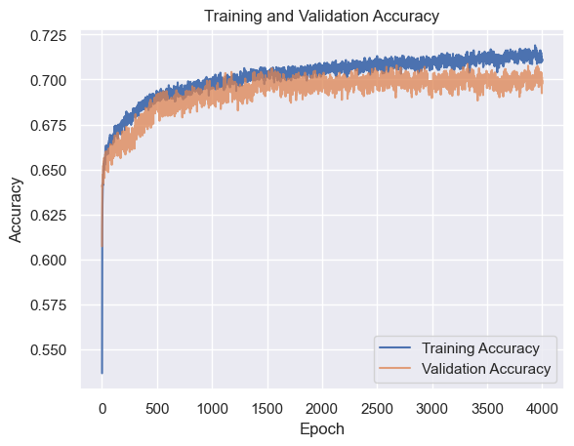
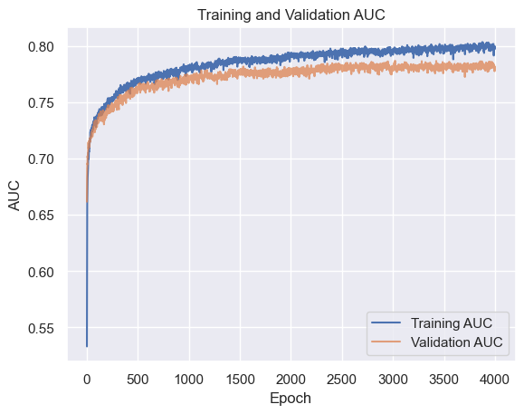
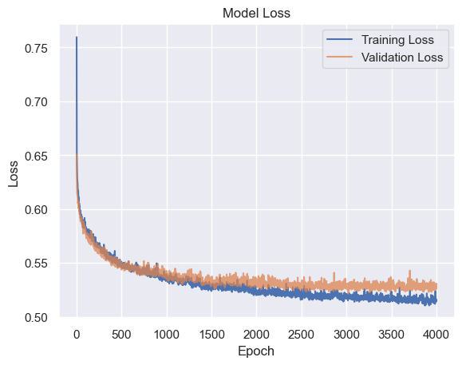
Neural Network (7/9)
Results (1/2)

Slide 26
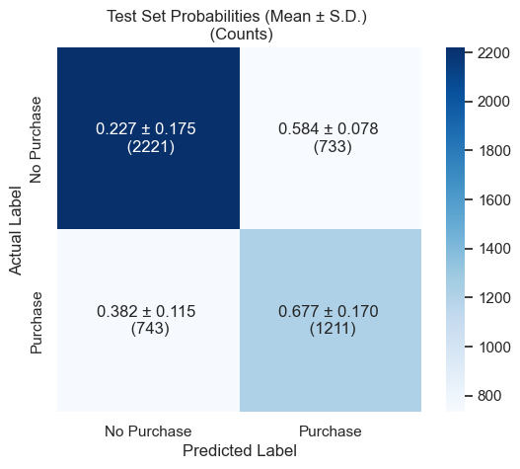
Neural Network (8/9)
Results (2/2)

Slide 27
Neural Network (9/9)
Hyperparameter Optimization
Our future work involves performing hyperparameter tuning using grid search with the NNI Python package (refer here for an overview of NNI)
Below is a table of the ranges of 8 hyperparameters we want to test
( indicates values used for results in the main presentation)
# Epochs | 500 1000 2000 4000
Batch Size | 32 64 128 256 512 1024
Step Size | 0.00075 0.001 0.0025
# Nodes in Layer 1 | 32 64 128 256
Dropout Value in Layer 1 | 0.1 0.2 0.3
# Nodes in Layer 2 | 32 64 128 256
Dropout Value in Layer 2 | 0.1 0.2 0.3
Activation Function | sigmoid tanh relu

Slide 28
a) Standard neural network
b) Applying dropout
Notes:
60 seconds
Tori (LR) and Ethan (NN)
57 seconds
Tori: Include output of both models are values between 0 and 1 that can be interpreted as the probability a user will make a purchase
Notes
mention data that we’re working with and how we are training the model
backup slide to include information about a neural network and basics
can include some references for help
limit for technical info
can include word shallow
impression that input and hidden layers have the same number of nodes (increase number of circles in hidden layer)
Include definition of hyperparameters (intuitively can be thought of as settings of the network that are chosen before it predicts any kind of data (e.g., number of layers))

Slide 29
ROC Curve
True Positive Rate
0 1
0.5
0 1
0.5
False Positive Rate
Notes:
60 seconds
Tori (LR) and Ethan (NN)
57 seconds
Tori: Include output of both models are values between 0 and 1 that can be interpreted as the probability a user will make a purchase
Notes
mention data that we’re working with and how we are training the model
backup slide to include information about a neural network and basics
can include some references for help
limit for technical info
can include word shallow
impression that input and hidden layers have the same number of nodes (increase number of circles in hidden layer)
Include definition of hyperparameters (intuitively can be thought of as settings of the network that are chosen before it predicts any kind of data (e.g., number of layers))

Slide 30
2 Hidden Layers
(256 Nodes; 256 Nodes)
Input
(𝑁 Observations,
30 Features)
Output
(𝑁 Predictions)
(𝑁×30)
(30×256)
(256×256)
(256×1)
𝑁×1
× × × =
𝐗
𝐖⁽¹⁾
𝐖⁽²⁾
𝐖⁽³⁾
ŷ
Notes:
Notes
important variables
explanation of / reference to neural network
explain how arrows between layers represent connections. The value of the connections determines how ‘important’ a connection is
model training consists of figuring out these weights

